Slide 1
UML Diagrams
Context Diagram, Data Flow Diagram, Activity Diagram, Swimlane Diagram, Use case

Slide 2
Context Diagram
It’s called Bird’s Eye View of a System
It contains only one process node (Process zero or 0) which is basically the System
System or the process zero node is connected with the External Entities or the type’s of user of the System

Slide 3

Rules of Context Diagram
There must be a single process node which is define as
External Entitles should be in Capital Letters

Slide 4





Context Diagram
Features:
Only one process (numbered 0)
External entities as squares, rectangle
Line shows data flows
No data stores are shown

Slide 5
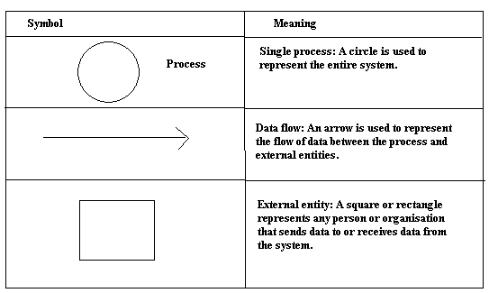
Symbols of Context Diagram

Slide 6
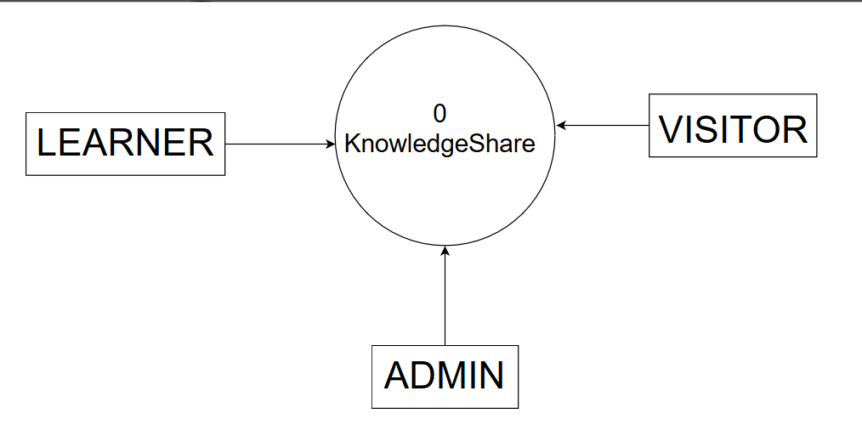
Context Diagram (Example: eLearning System)
System name is Knowledge Share, zero represents the only process in context diagrams,
And External Entities are LEARNER, VISITOR, ADMIN.

Slide 7
Data Flow Diagram
DFD represents the flow of data or information for any process or system
Common components of DFD are:
Process
External Entities
Database / Files
Data Flow

Slide 8
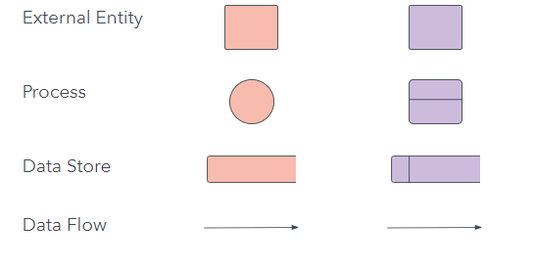
Symbols of DFD

Slide 9
Rules of DFD
Database, External Entities names should be in Capital letters
DFD should be started from Top-Left and ended to Bottom-Right
There should not be any connection between DB to DB, DB to external entities
Process should have name and number

Slide 10
Rules of DFD:
1. Flows from: Left to right; Top to bottom
2. External Entity(EE) – Process, Process – Process, Process – Data File : OK
3. EE – EE, EE – Data File, DB – DB : NO
4. Used Four Symbols only
5. Each process has name and numbered
6. EE, Data Files are written in Capital Letter
7. Process names first letter of each word will be written in Capital letter

Slide 11
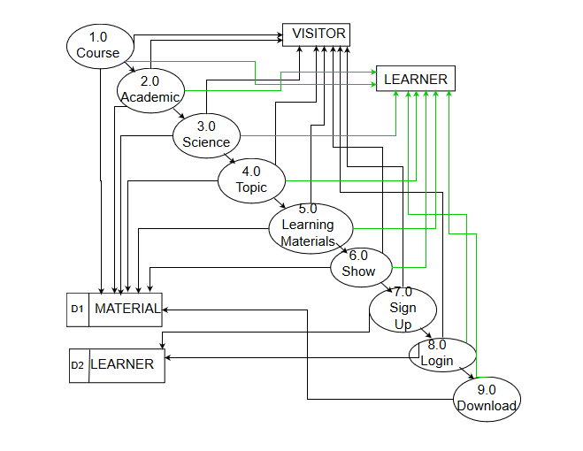
Data Flow Diagram Example: eLearning System

Slide 12
Activity Diagram
Activity Diagram is a flowcharts that represent flows from one activity to another
Common components of activity diagrams are: Action, Start State, End State, Fork and Join, Control Flow, Decision.

Slide 13



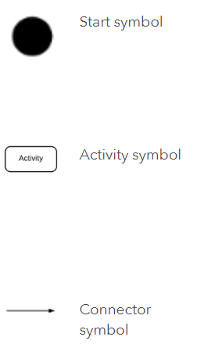
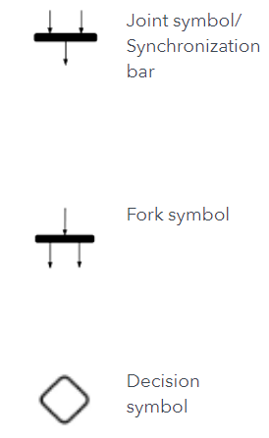
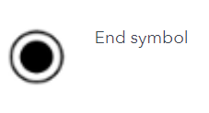
Symbols of Activity Diagram

Slide 14
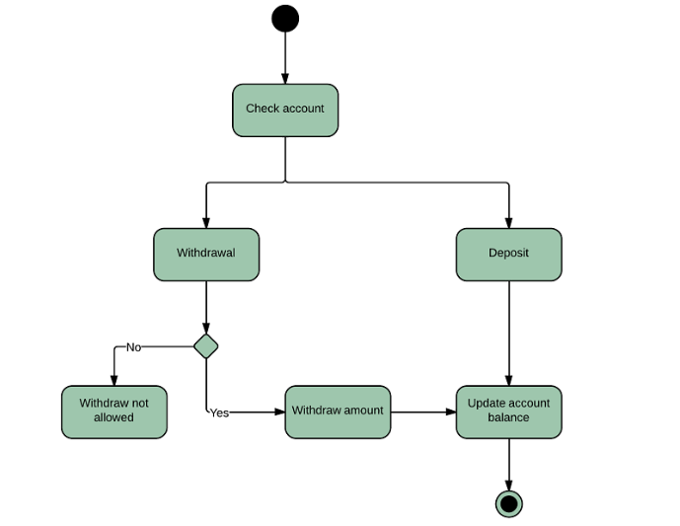
Example of Activity Diagram(Banking System)

Slide 15
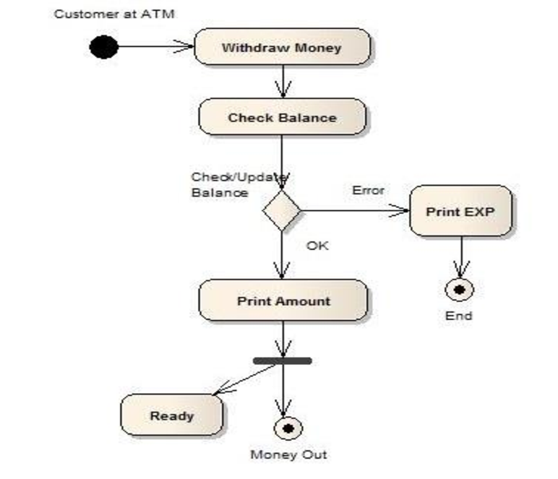
Example of Activity Diagram(Withdraw money at ATM Booth)

Slide 16
Tools to draw UML Diagrams
https://www.genmymodel.com/
https://creately.com/
https://www.draw.io/
Many more ……… Search in Google ☺

Slide 17
Use Case Diagram
Use case diagrams describe what a system does from the standpoint of an external observer. The emphasis is on what a system does rather than how.
Use case diagrams are closely connected to scenarios. A scenario is an example of what happens when someone interacts with the system. Here is a scenario for a medical clinic.
"A patient calls the clinic to make an appointment for a yearly checkup. The receptionist finds the nearest empty time slot in the appointment book and schedules the appointment for that time slot. "

Slide 18

A use case is a summary of scenarios for a single task or goal.
An actor is who or what initiates the events or task.
The picture below is a Make Appointment use case for the medical clinic. The actor is a Patient.
Use cases are ovals.
Communications are lines that link actors to use cases.

Slide 19
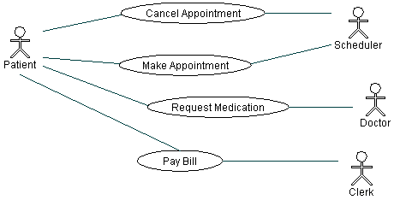
Make Appointment use case diagram with four actors and four use cases. Notice that a single use case can have multiple actors.

Slide 20
Use Case (descriptive form):
Use case number and name
Primary Actor
Stakeholders and Interests
Preconditions
Success Scenario
Alternate Scenario
Post-conditions

Slide 21
Example of Use case Modeling for a supermarket
Cashier
Sell Item
Customer

Slide 22
Use Case UC 01: Sell Item
Primary Actor: Cashier
Stakeholders and Interests:
-Cashier: Wants accurate, fast entry and no payment errors
-Customer: Wants purchase and fast service with minimal effort. Wants receipt if future return of product is necessary.
Company: Wants to accurately record transactions and satisfy customer interests.
Government Tax Agencies: Wants to collect tax from every sale.

Slide 23
Conditions
Preconditions: Cashier is identified and authenticated.

Slide 24
Success Scenario
1.Customer arrives at counter with goods to purchase.
2.Cashier starts a new sale.
3.Cashier enters item identifier.
4.System records sale item and presents item description, price and running total.
Cashier repeats steps 3-4 until indicates done

Slide 25
Success Scenario ( Cont..)
5.System presents total with tax calculated.
6.Cashier tells customer the total and asks for payment.
7.Customer pays and system handles payment.
8. System presents receipt.
9.Customer leaves with receipt and goods.

Slide 26
Alternative Scenario:
*a At any time, System fails:
1.Cashier restarts System, logs in and request recovery of prior state.
2.System re-constructs prior state.
3a. Invalid identifier:
1.Signals system error and rejects entry.
Manual Entry given

Slide 27
Alternative Flow (cont..)
3-6 a) Customer asks cashier to remove an item.
i. Cashier enters item identifier for removal of sale.
ii. System displays updated running total.
3-6 b) Customer tells cashier to cancel sale.
i. Cashier cancels sale on System.

Slide 28
Post-conditions: Sale is saved. Tax is correctly calculated. Accounting and inventory updated. Receipt is generated.

